Slide 1


Employee Identification and Tracking
Scope Presentation

Slide 2

Group
Muhammad Umer Naeem
CIIT/FA17-BSE-140/ISB
Hamza Tahir
CIIT/FA17-BSE-148/ISB
Supervisor
Mr. Umar Nauman

Slide 3
Project Category
Web Application
Problem Solving and Artificial intelligence
Smartphone Application
Image Processing
Industrial Project

Slide 4
Introduction
Employee identification and tracking are web and smartphone applications that provide a real-time platform to monitor employees and visitors in the facility.
This system uses RFID sensors and surveillance cameras to track the location of a user. The system users can register with proper roles and permissions to use the application.
Many systems in the market support RFID location tracking, but RFID sensing efficiency is affected by environmental factors. Moreover, there are many chances that the employees can cheat in that case as the system can not track their activities.
Our proposed solution uses RFID and security cameras to get the user's location with improved accuracy. Also, get the report for the overall time spent of that user at various locations.
The system also supports searching the user's location using the database registered person's entity or uploading an image.

Slide 5
Problem Statement
In large organizations, managing and tracking employees during working hours is always a challenge for the managers. Sometimes the employees get way too casual, which ultimately affects the employee's efficiency, resulting in less productivity.
The primary purpose of developing this system is to let the employer track the employees' all-day location. Many similar systems exist in the market, supporting facial recognition attendance but do not provide the tracking of location and real-time analytics for the employees.
The currently available systems do not support searching for real-time locations using the images or their names registered in the system. Also, the current systems do not support the visitors tracking in the office. We expect to learn machine learning, web development, computer vision, and mobile application after implementing it.

Slide 6
Related System Analysis
Application Name | Weakness | Proposed Project Solution
Jibble.io | The application only takes the attendance of employees using their webcams. The application does not track the location of the employees. The application does not give real-time surveillance. | The proposed solution shall use security cameras to monitor the attendance of the employees. With the help of RFID cards and a camera, the system shall also monitor the location. The system shall be able to generate an overall report for the employees.
Hexahash.com | The employees can dodge the application for attendance by sharing RFID cards with other employees. The application does not support searching for visitors' locations using an image. The application does not generate report for the employees. | The proposed solution shall double-check the employee with the help of cameras as well as RFID cards. The system shall be able to generate an overall report for the employees. The system shall support real-time searching for users' locations within the facility using both image and name.
Litumiot.com | The employees can dodge the application for attendance by sharing RFID cards with other employees. The application does not support searching for visitors' locations using an image. The application does not generate report for the employees. | The proposed solution shall double-check the employee with the help of cameras as well as RFID cards. The system shall be able to generate an overall report for the employees. The system shall support real-time searching for users' locations within the facility using both image and name.

Slide 7
Advantages of Proposed System
Get real-time tracking and surveillance of employees and visitors.
Identify the location of users within the facility.
Set up geofences.
Push notification for users violating geo-fencing.
Get personalized reports for each user.
Search users within the facility using names and pictures.

Slide 8
Scope
Our system is focused on offices that want to monitor their employee using an automated system. Once the user is registered on the system, he can create his organization and add users to the organization with different roles created by the user.
Once it is done, the user can add cameras and RFID sensors, and label them with their positions. Now the system is ready for use, and the user with appropriate permissions defined in the roles can add an employee with their images to train the system. As soon as the employee is registered, the system will be trained with the employees face and issued with an RFID card.
As the employees are registered, the employees will be clocked in based on the camera at the entrance and clocked out. An overall report of employees can also be reviewed at any time. Moreover, warning and challans can also be generated and sent to the employees.
The system also allows the user with appropriate permissions to search a user with an image or name to search for the location. The same system will be used to monitor the visitors in the office.

Slide 9
Modules
Facial Detection
Model Training
RFID Configuration
Model Deployment and Tracking

Slide 10
Modules (Continued)
Mobile Application
Development
Web Application
Development
RFID Tracking

Slide 11
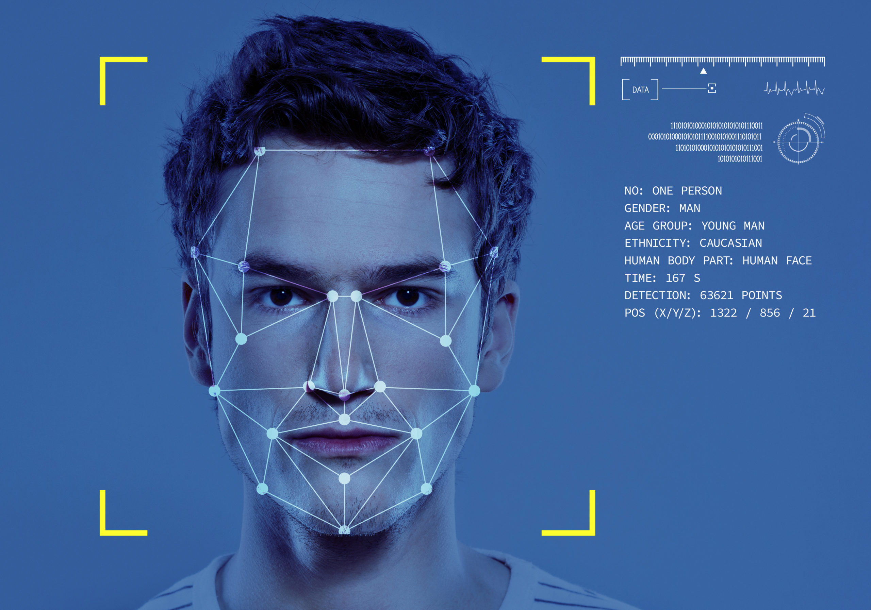
Facial Detection
This module shall help the system to detect faces from the video and images. In this module, the system shall first scan the faces to detect all faces. The second is to check if any of the faces need some enhancements. The third is to select all the facial features and return them as encoding that can be used to compare with other faces.

Slide 12
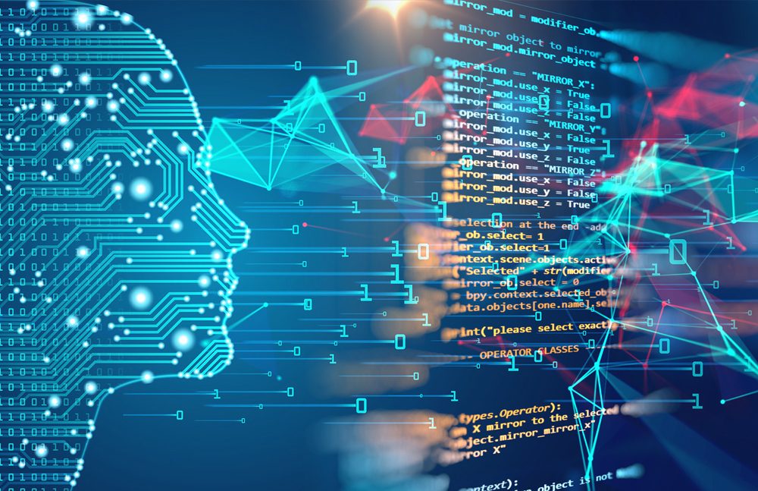
Model Training
This module shall train the system by running a machine learning algorithm by giving it data to learn. We shall train the faces to detect individuals inside the facility whenever the user is in the video feed.

Slide 13
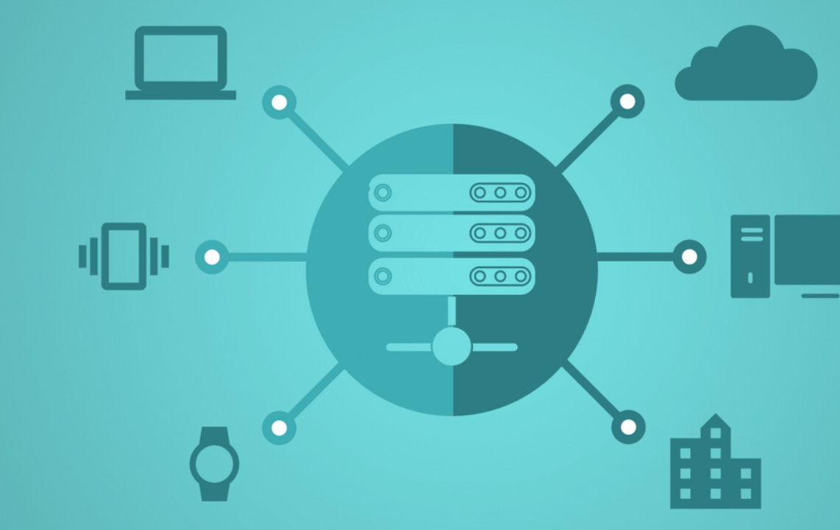
Model Deployment & Tracking
This module involves model deployment, enabling the system to use these models to perform the classification. Moreover, the system shall relate the profile stored in the database with the faces detected.

Slide 14
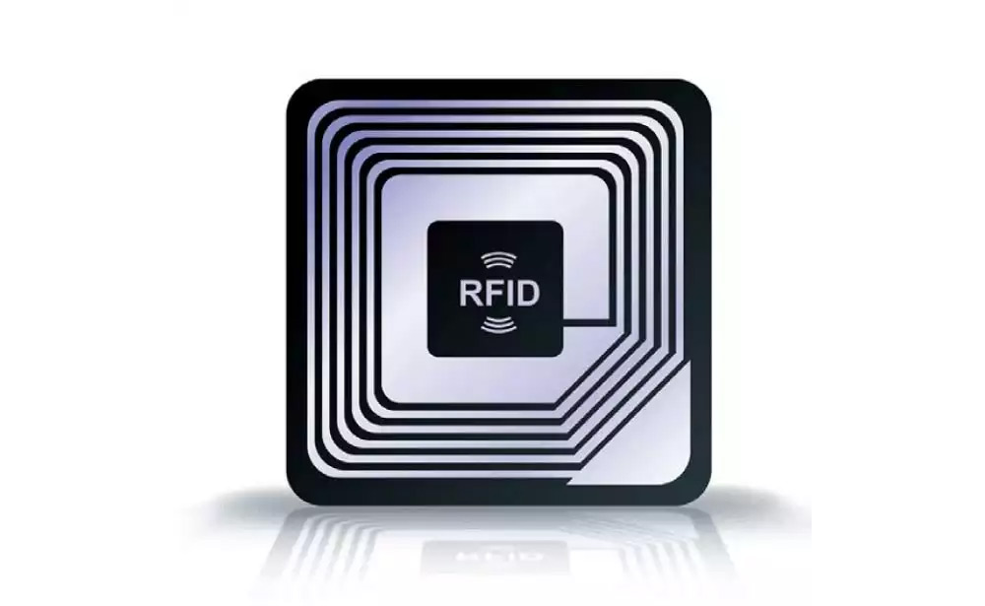
RFID Configuration
This module involves the management of RFID cards. This will allow the system user to create new RFID cards as well as manage the existing RFID cards to map them with the user's profile.

Slide 15
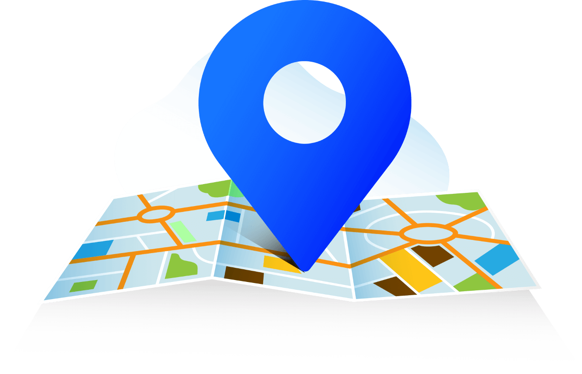
RFID Tracking
As the RFID sensors have fixed locations and the RFID sensors are labelled with different locations. This module shall enable the system to track the location of the user within a particular location as well as cross check it with the camera feed to validate the location.

Slide 16


Web Application Development
This module involves creating the backend API's as well as front-end to interact with the business logic. Moreover, this will include user profiling, localization, multiple-tenants, Roles and Permissions, Social Media Logins, Two Factor Authentication, Hierarchal organization unit's system to group users and entities, real-time push notifications, report generation, and analytics.

Slide 17

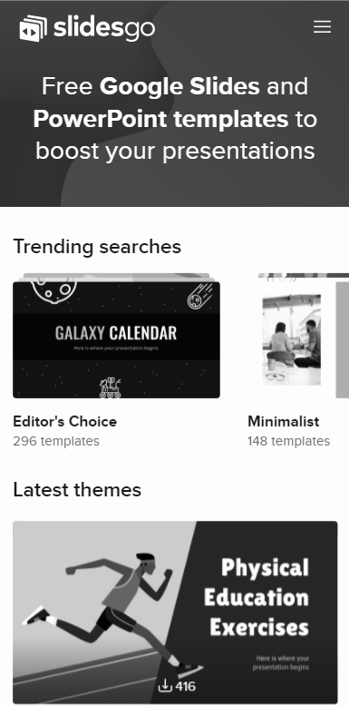
Mobile App Development
This module involves the development of an android native mobile application. The application will send real-time requests to the web application's backend to perform all kinds of actions and receive a real-time push notification.

Slide 18
System Limitations
The system requires the internet to operate.
The system requires RFID sensor in each room.

Slide 19
Design methodology
Software process methodology
For our proposed solution, we shall use the Rapid Application Development methodology. The reason for using this model is because it focuses more on testing and iteration. Moreover, all the modules of the application are integrated from the beginning leading to fewer errors.
To develop our proposed solution, we shall use the SOLID design principle (Object-Oriented Design Principle). We are using this design methodology because it makes the code extendable and flexible with overall improved quality

Slide 20
Tools and Technologies
Tools And Technologies | Tools | Version | Rationale
 | MS Visual Studio | 2019 | IDE
 | Visual Studio Code | 1.49.3 | IDE
 | Spyder | 4.1.5 | IDE
 | Android Studio | 4.0.2 | IDE
 | MS SQL Server | 2014 | DBMS
 | Adobe Photoshop | 2020 | Design Work
 | MS Word | 2015 | Documentation
 | MS PowerPoint | 2015 | Presentation
 | Pencil | 2.0.5 | Mockups Creation
 | Technology | Version | Rationale
 | C# | 8.0 | Programming language
 | Python | 3.6 | Programming language
 | Java | 11 | Programming language
 | SQL | 2014 | Query Language
 | Html | 5 | Web Development
 | ASP.NET Core | 3 | Web Development
 | Angular | 7 | Web Development
 | CSS | 3 | Web Development

Slide 21
Project Stakeholders and Roles
Project Sponsor | COMSATS University Islamabad
Stakeholder | Mr. Umar Nauman (Project Supervisor) Muhammad Umer Naeem, Hamza Tahir (Students) Final Year Project Committee (Evaluation of project)

Slide 22
Work Division
Student Name | Student Registration Number | Responsibility/ Modules
Muhammad Umer Naeem | FA17-BSE-140 (Student 1) | Module-1: Facial detection Module-3: Model deployment and tracking Module-5: RFID Tracking Module-6: Web Application Development Web-Backend, Web-Frontend, Database Management, Machine Learning, Image Processing
Hamza Tahir | FA17-BSE-148 (Student 2) | Module-2: Model Training Module-4: RFID Configuration Module-7: Mobile Application Development Machine Learning, Database Management, Image Processing, Android Development, Web Backend

Slide 23
Data Gathering
Interviews:
We used interviews to gather data from the project stakeholders. This interview also had a question related to the problems they were facing to track the employees. This interview was to gather all requirements and the confusion that we had in our minds.
Observation
We visited the stakeholder and observed their employee. We noted the building measurements to measure the dimensions to use suitable sensors to track the employees.

Slide 24

Concepts

Slide 25
Data Gathering
Concept 1: Machine Learning
Machine learning is an application of Artificial intelligence in which we write an algorithm that takes the labeled data to train itself and make appropriate decisions with new data. In this project, we have used machine learning to recognize faces and track activities.
Concept 2: Databases
Storing any information on a computer server electronically and viewing it in a manner that is the end user's necessity. It is possible to modify this stored data as the user communicates with the device. Databases also only provide managed access to protect the user's privacy and provide them with data protection and dignity.
Concept 3: Image Processing
Image processing is a method to perform some operations on an image to get an enhanced image or extract some useful information. We have used image processing to detect faces from the video feed

Slide 26
Data Gathering (Continued)
Concept 4: Mobile Development
Mobile application development is a process by which we develop an application that can run on smartphone devices. These mobile applications are written to serve for a specific purpose and take advantage of those mobile devices' features.
Concept 5: Web Application Development
Web Application Development is a programming technique that enables us to get the desired functionality as per the stakeholder's requirements by providing an interface to the user. Website development includes client-side, server-side scripting. These websites are hosted over the internet to access them remotely anywhere from the internet.

Slide 27
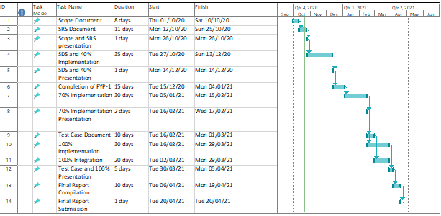
Gantt Chart

Slide 28
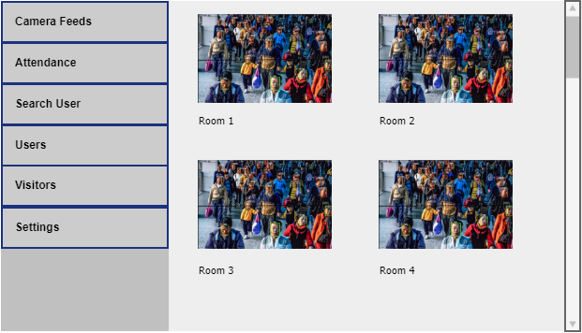
Mockups

Slide 29
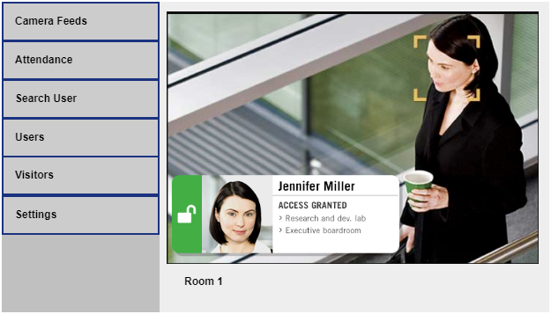
Mockups

Slide 30
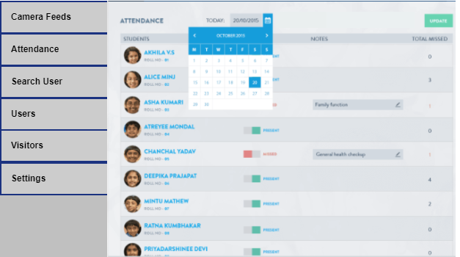
Mockups

Slide 31
Conclusion
The scope document for Employee Tracking and Identification is providing all the initial details regarding the system, the need for the system, problems the existing systems have, and their solution.
This document describes the main functionality, Gantt charts, and the mockup with the system's timing constraints described.
This document is used as an initial proposal. All the development later in this project will be based on this. This project will learn Machine Learning, Image Processing, Web development, android development, and database management. We will try to complete the project on time and make it a complete product.

Slide 32
References
Chu Luo, "Video Summarization for Object Tracking in the Internet of Things", Next Generation Mobile Apps Services and Technologies (NGMAST) 2014 Eighth International Conference on, pp. 288-293, 2014.
Ching-Sheng Wang, Chien-Liang Chen, "RFID-based and Kinect-based indoor positioning system", Wireless Communications Vehicular Technology Information Theory and Aerospace & Electronic Systems (VITAE) 2014 4th International Conference on, pp. 1-4, 2014.
Sommerville, I. (2011). Software engineering (9th ed.). Boston: Pearson.
Pressman, R. (2020). Software engineering (7th ed.). Boston, Mass.: McGraw Hill.
Meyer, B. Object-oriented software construction. London: Prentice-Hall International.
Mitchell, T. (2017). Machine learning. New York: McGraw Hill.

Slide 33

Any Questions?

